Slide 1

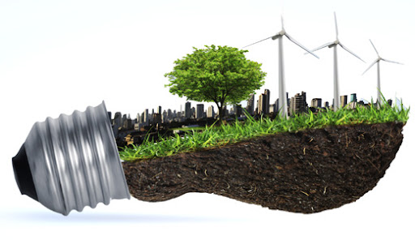
NON CONVENTIONAL ENERGY RESOURCES
WIND POWER ENERGY
GUIDED BY:-
Dr. Rajakumar D. G. Professor,
Department of Mechanical Engineering,
GM Institute of Technology, Davangere-06
TEAM MEMBERS:-
1) SAGAR R
2) VASANTH KUMAR C
3) VIJAY KUMAR BR
4) VISHWAS MN

Slide 2
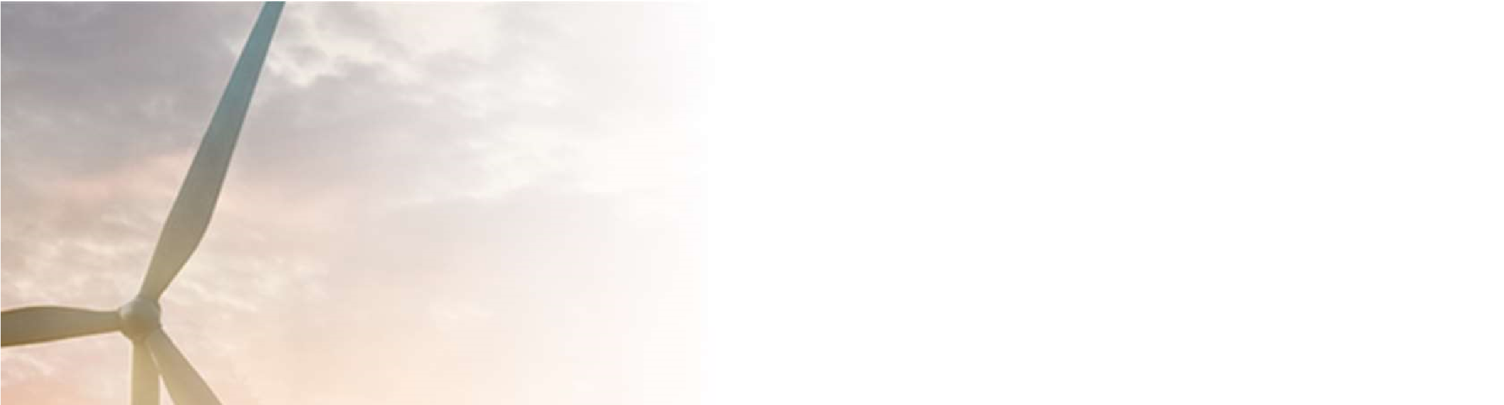
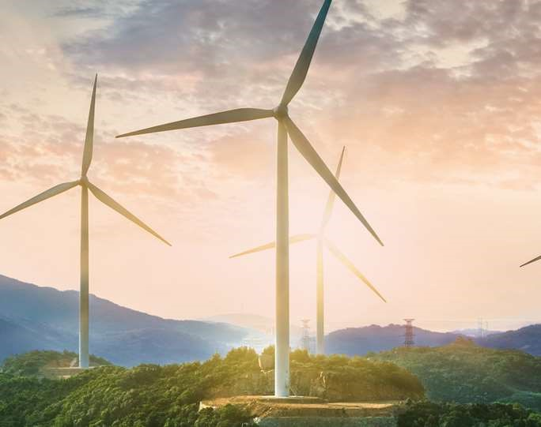


WIND
POWER
PLANT
An Ultimate Renewable Source of
Energy

Slide 3


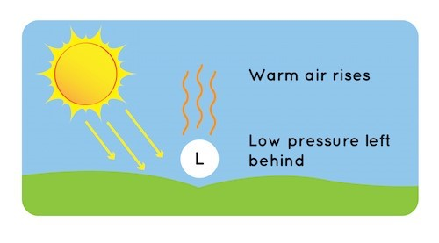
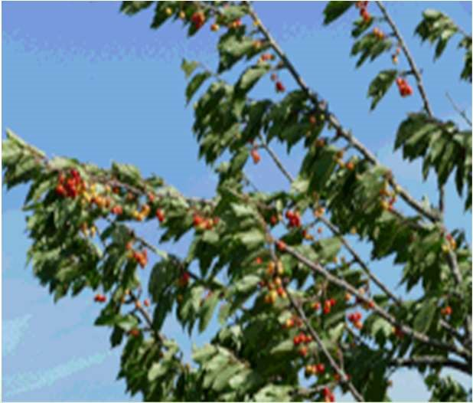

What Makes Wind?
➢
Wind energy is created when the atmosphere is heated unevenly by
the sun, some patches of air become warmer than others.
➢
These warm patches of air rise, other air rushes in to replace them.
Thus wind blows.

Slide 4
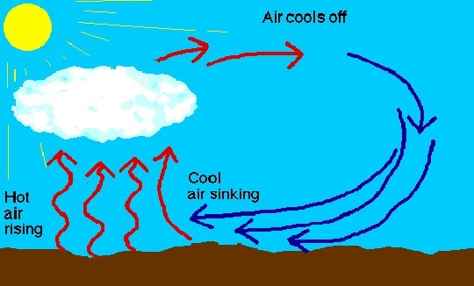
What Makes Wind?
➢
The wind is a by-product of solar energy. Approximately 2% of the
sun’s energy reaching the earth is converted into wind energy.
➢
The surface of the earth heats
and cools unevenly, creating
atmospheric pressure zones
that makes air flow from high
to low pressure areas.

Slide 5


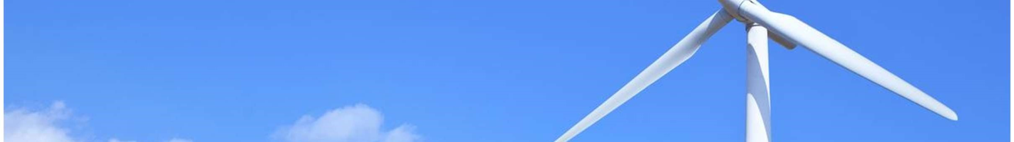

Wind Power Plant
➢
A wind farm or wind park, also
called
a
wind
power
station or wind power plant, is a
group of wind turbines in the
same location used to produce
electricity. Wind farms vary in
size from a small number of
turbines to several hundred wind
turbines covering an extensive
area. Wind farms can be either
onshore or offshore.

Slide 6
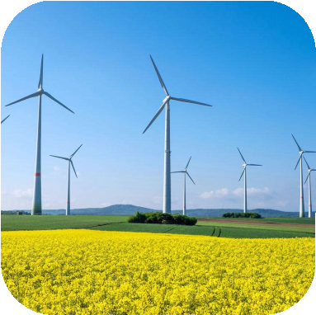
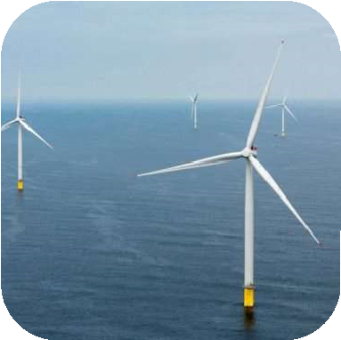
Types of Wind Power Plant
Wind Power Plant
A. Onshore Wind Farm
B. Offshore Wind Farm

Slide 7
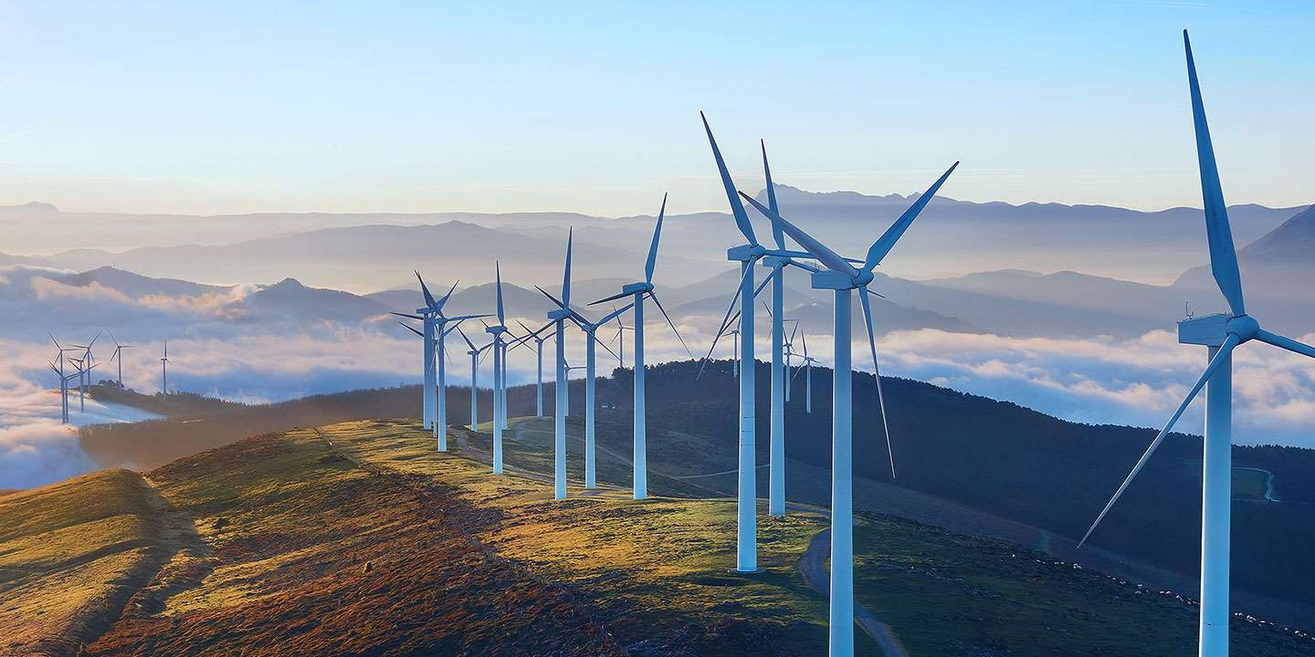
A. Onshore Wind Farms:
➢
Onshore wind farms are groupings of wind turbines clustered into a windy area on
land.
➢
Each turbine sits atop a large steel tube (called a "tower") that gets it exposure
to wind blowing at higher speeds. A series of blades spin the axis of the
turbine when the wind blows over them.

Slide 8
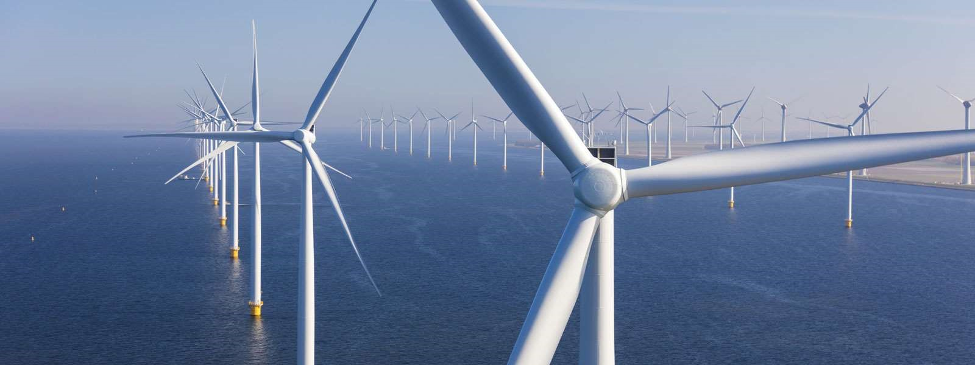
B. Offshore Wind Farms:
➢
Offshore wind farms are collections of wind turbines located in water.
➢
They are often built in the ocean but also on lakes and fjords when wind speeds
are strong enough. Offshore wind farms generally experience stronger wind
speeds due to their location. They are capable of harnessing a colossal amount of
power.

Slide 9
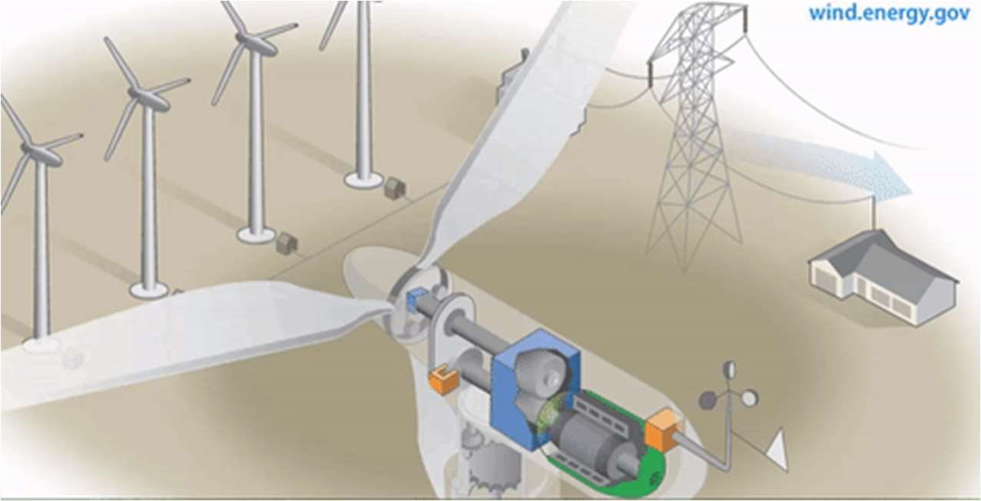

Wind Turbines
A wind turbine is a machine that converts kinetic energy from the wind into
electricity. The blades of a wind turbine turn between 13 and 20 revolutions per
minute, depending on their technology, at a constant or variable velocity, where the
velocity of the rotor varies in relation to the velocity of the wind in order to reach a
greater efficiency.

Slide 10
Types of Wind Turbines
Horizontal-Axis Turbines
Vertical-Axis Turbines
Unconventional Type

Slide 11
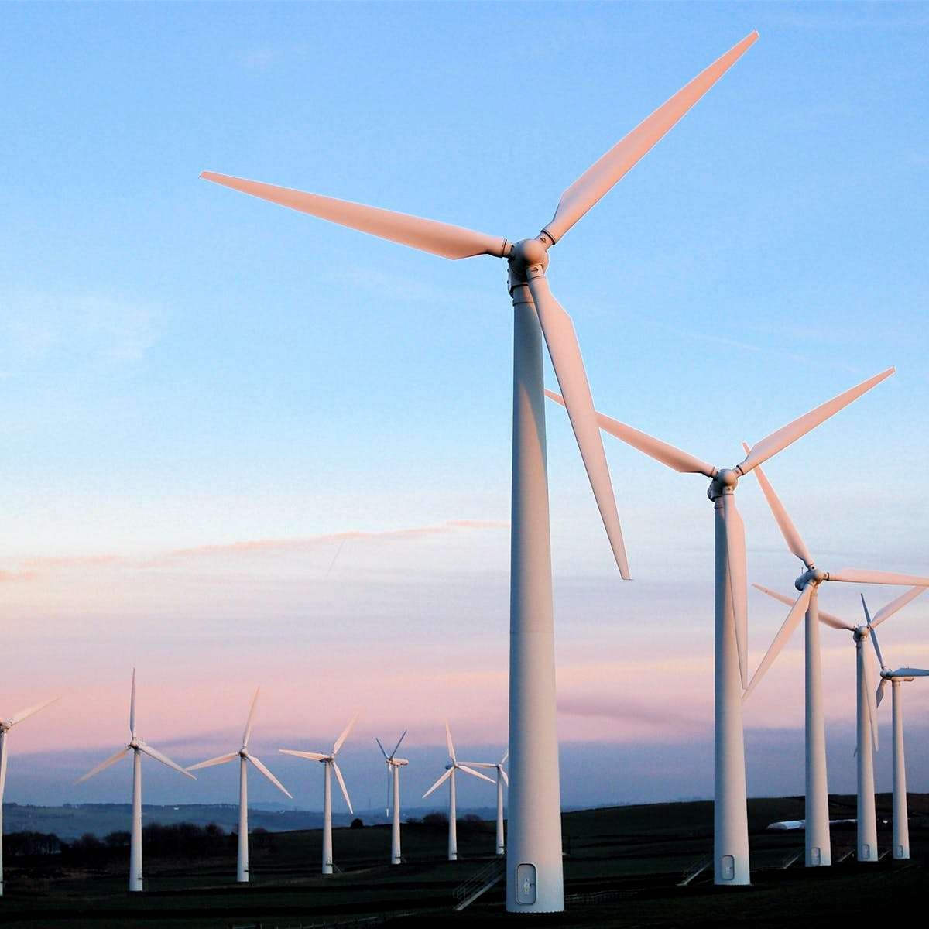
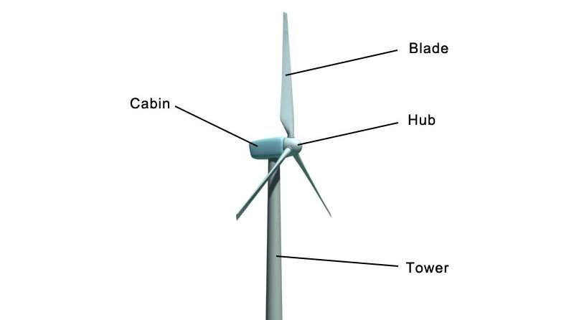
A. Horizontal-Axis Turbines:
➢
They most commonly have three blades and are operated "upwind," with the
turbine pivoting at the top of the tower so the blades face into the wind.

Slide 12
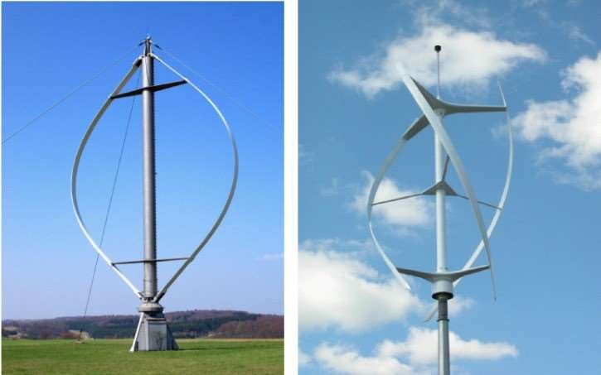
B. Vertical-Axis Turbines:
➢
Vertical-axis wind turbines come in several varieties, including the eggbeater-
style Darrieus model, named after its French inventor. These turbines are
unidirectional, meaning they don't need to be adjusted to point into the wind to
operate.

Slide 13

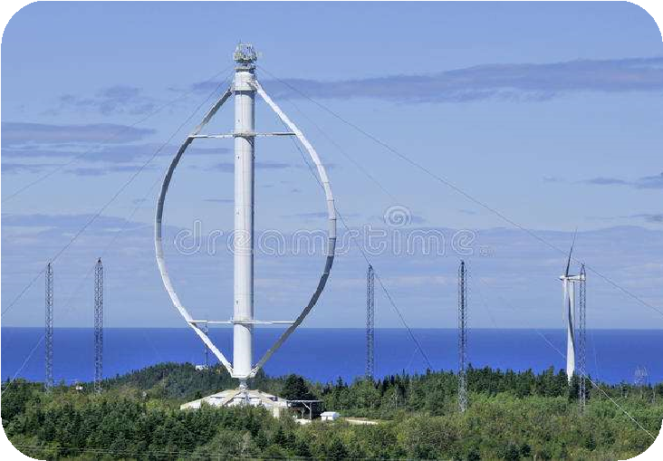
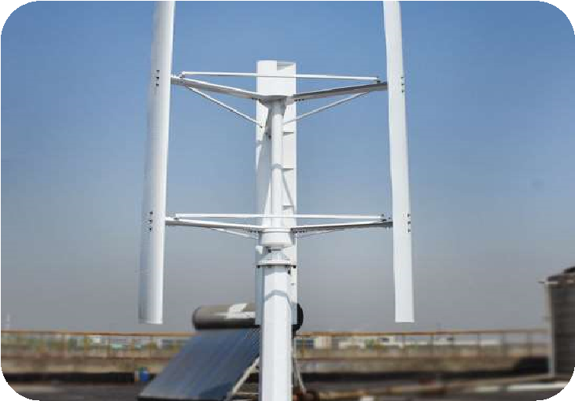
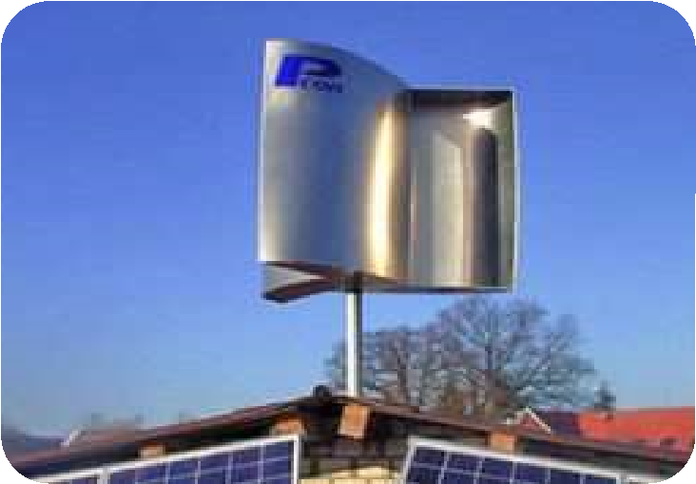
Types of Vertical-Axis Turbines:
Darrieus
Giromill
Savonius
Wind
Wind
Wind
Turbine
Turbine
Turbine

Slide 14
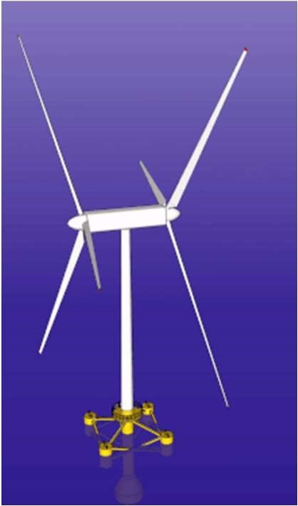
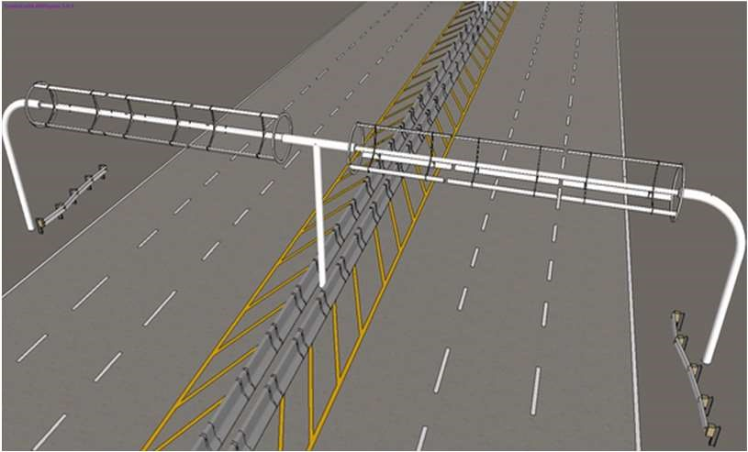
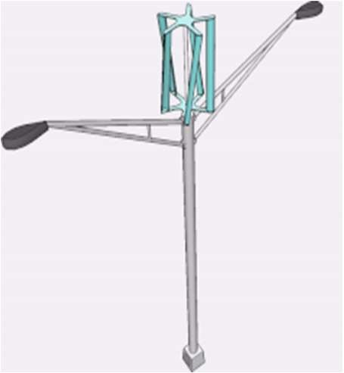
C. Unconventional Type:
Counter rotating
Highway wind turbine
Light pole wind
wind turbines
turbine

Slide 15
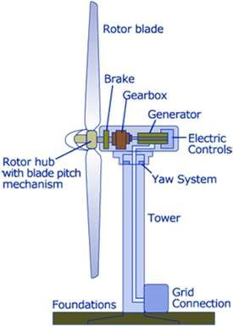
Wind Turbines Components
1
• Turbine Blades
2
• Tail Section
3
• An Alternator
4
• Rectifier
5
• Electricity Cables
6
• Slip Rings
7
• Electric Elements
8
• Tower
9
• Gearbox
10
• Yaw System
11
• Concrete Foundation

Slide 16
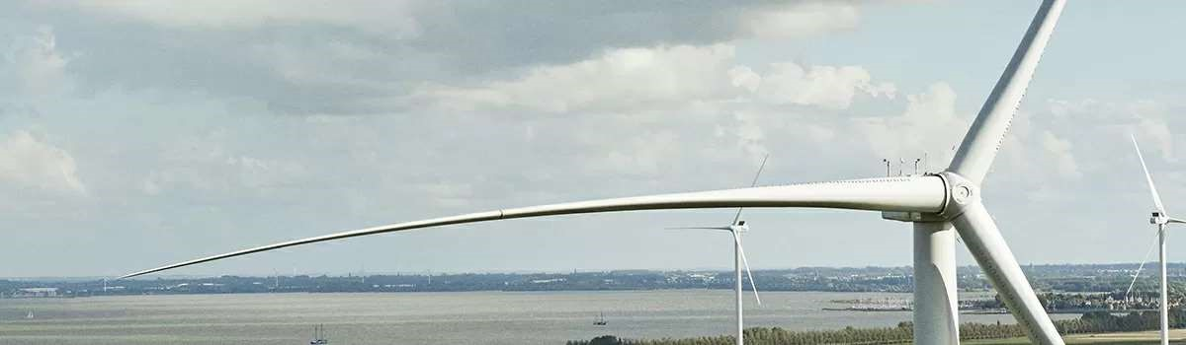
1
. Turbine Blades
:
➢
propellers with two, three or five blades mounted on the horizontal shaft (this
gives higher output than when they are mounted on the vertical shaft) and made
of a lightweight material such as carbon fibre, fibre glass or wood, that is strong
enough to resist wind forces.

Slide 17
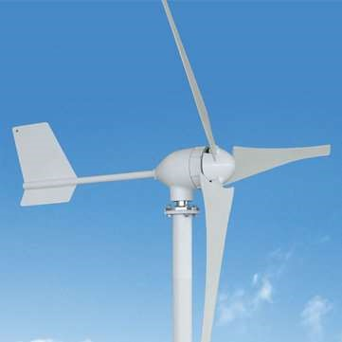
2
. Tail Section
:
➢
Generally a fin that rotates the body of the wind generator to turn the turbine into
the direction of the wind, with the fin directly downwind.
Tail Section

Slide 18
3
. Alternator
:
➢
An alternator converts the turning motion of a wind turbine’s blades into
electricity. Inside this component, coils of wire are rotated in a magnetic field
to produce electricity.
4
. Rectifier
:
➢
Converts AC to DC for electricity that is being sent to a battery storage system
(
the rectifier may be located in the alternator or in a separate control box away
from the tower).
5
. Electricity Cables
:
➢
Transfer the electricity from the generator to the electricity supply or battery
storage system.

Slide 19
6
. Slip Rings
:
➢
Stop the cables twisting as they will otherwise twist within the tower as the
turbine body rotates.
7
. Electric Element
:
➢
Power is always produced when the turbine spins, so if the power is excess to
storage capacity, it must be redirected to a dummy load (generally an electric
element that gets very hot) or sold (if permitted under the district plan) to an
electricity retailer.
8
. Tower
:
➢
The structure (usually steel, concrete or wood) that holds the turbine high in the
air, and allows the turbine assembly on top to rotate into the wind – for
residential applications, it is typically a mast pole with guy wires.

Slide 20
9
. Gearbox
:
➢
A gearbox is often used in a wind turbine to increase the rotational speed from a
low-speed main shaft to a high-speed shaft connecting with an electrical
generator.
10
. Yaw System
:
➢
The yaw system of wind turbines is the component responsible for the
orientation of the wind turbine rotor towards the wind.
11
. Concrete Foundation
:
➢
A 2–3 kW turbine on a 10–15 m tower will typically require a 3–5 m3 reinforced
concrete foundation.

Slide 21
Site Selection
➢
Selecting an appropriate site is key to success of any renewable energy project,
financially and technically.
Some of the main site selection consideration are given below:
1.
High annual average wind speed
2.
Availability of anemometry data
3.
Availability of wind V(t) Curve at the proposed site
4.
Wind structure at the proposed site
5.
Altitude of the proposed site
6.
Terrain and its aerodynamic
7.
Local Ecology
8.
Distance to road or railways
9.
Nearness of site to local Centre/users
10
. Nature of ground
11
. Favorable land cost

Slide 22
Advantages
➢
Air as a fuel is free and inexhaustible.
➢
It is clean source of energy and does note pollute the environment.
➢
The cost of electricity is too low and wind turbine could be used over more
than 20 years.
➢
It’s cheap as only the installation and maintenance cost is required.

Slide 23
Disadvantages
➢
It takes a lot of research and effort to decide the location where wind power plant
has to be installed, due to fluctuating pattern of wind.
➢
Its initial setup cost is too high as to setup a turbine you have to go through a
survey to determine the wind speed of the location. It all adds up to the cost.
➢
They are the greatest disadvantage to local bird population as they die due to
collision with blades.
➢
Noise pollution is the one of the major disadvantage.
➢
Wind power plant is only useful to the countries with coastal or hilly areas.

Slide 24
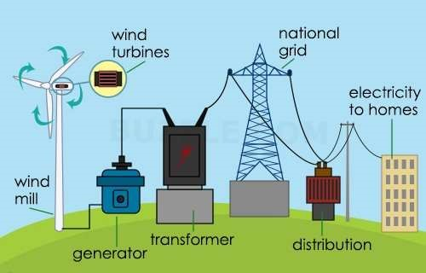
Applications
➢
It is mostly used for electricity generation.
➢
It is also used for water pumping through multi blade turbine.

Slide 25
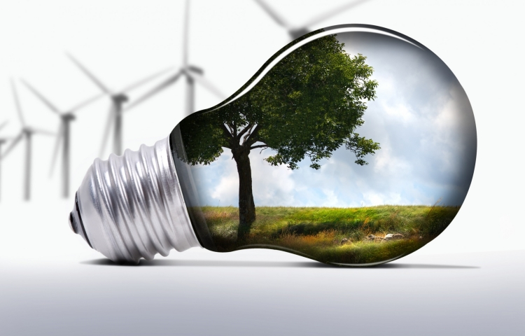
THANK YOU!

